Slide 1

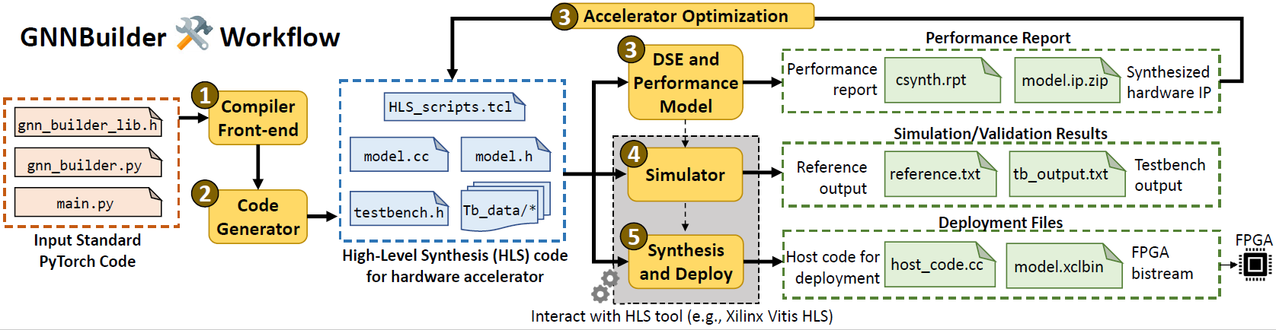

GNNBuilder An Automated Framework for Generic Graph Neural Network Accelerator Generation, Simulation, and Optimization
Stefan Abi-Karam^{1,2}, Cong Hao¹
¹Georgia Institute of Technology, ²Georgia Tech Research Institute
stefanabikaram@gatech.edu, callie.hao@ece.gatech.edu
Sharc Lab @ Georgia Tech sharclab.ece.gatech.edu

Slide 2
Background
DL for Graphs
GNNs
Accelerators
GNNBuilder
Generic Compute
Architecture
Design Space Exploration
Performance Results
Framework API
Limitations
Ongoing Work
Documentation and Open Source
Generic Compute
Architecture
Design Space Exploration
GNNBuilder
Performance Results
Framework API

Slide 3
Background
DL for Graphs
GNNs
Accelerators
GNNBuilder
Generic Compute
Architecture
Design Space Exploration
Performance Results
Framework API
Limitations
Ongoing Work
Documentation and Open Source
Generic Compute
Architecture
Design Space Exploration
GNNBuilder
Performance Results
Framework API

Slide 4

Deep Learning for Graphs
What “Deep Learning for Graphs” applications benefit most from hardware acceleration?

Slide 5
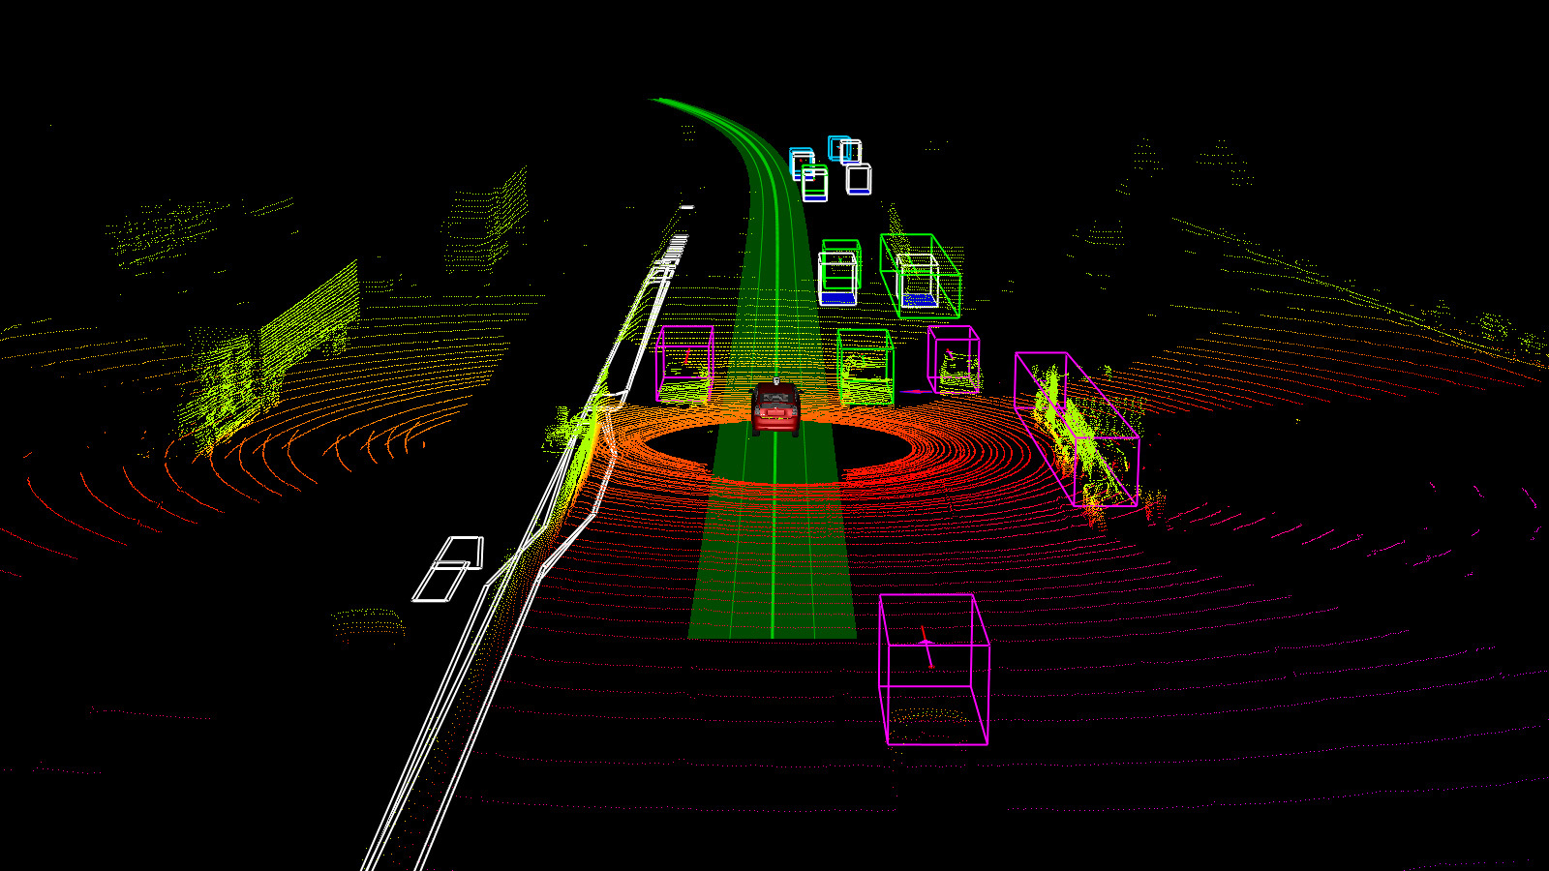

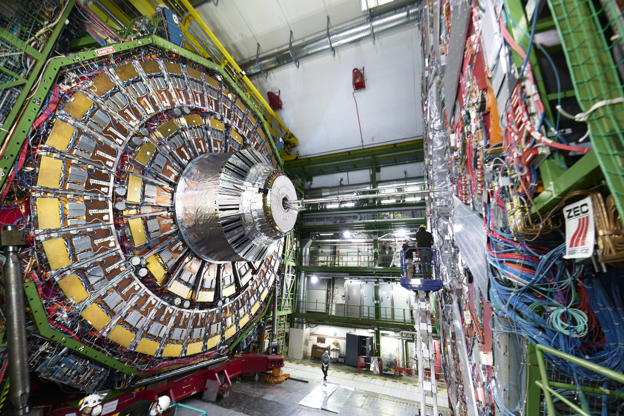

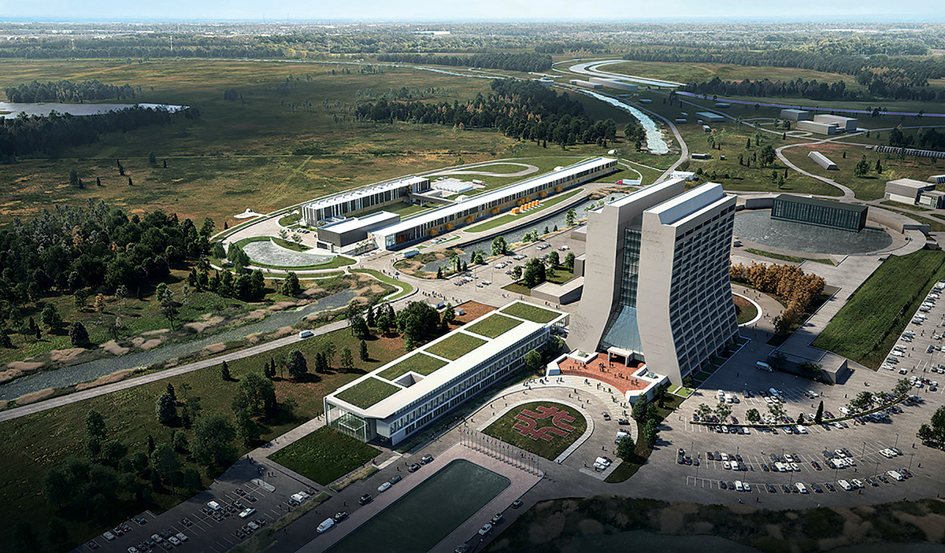
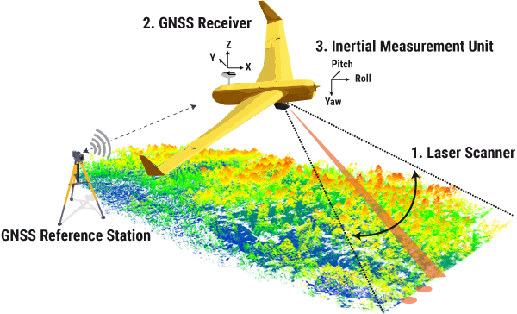
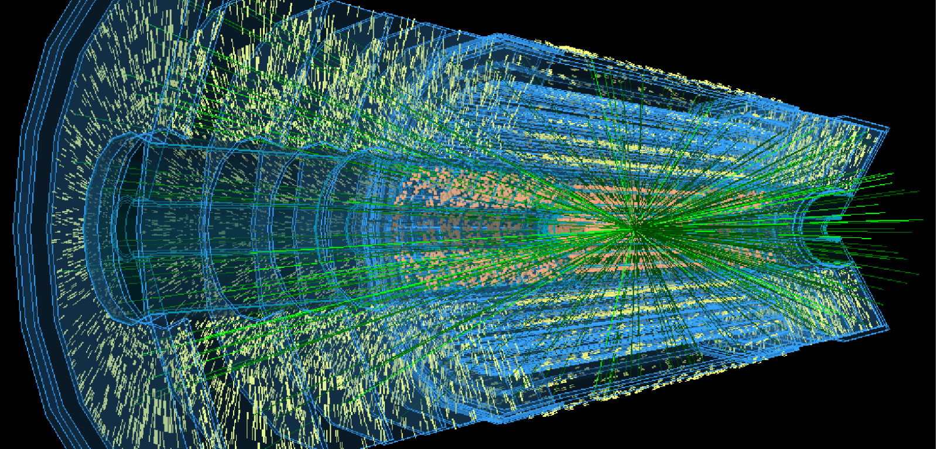
Deep Learning for Graphs
Point Cloud Processing
High Energy Physics!

Slide 6
Deep Learning for Graphs
Benefit from hardware acceleration for real-time inference!
Point Cloud Processing
High Energy Physics!

Slide 7
Background
DL for Graphs
GNNs
Accelerators
GNNBuilder
Generic Compute
Architecture
Design Space Exploration
Performance Results
Framework API
Limitations
Ongoing Work
Documentation and Open Source
Generic Compute
Architecture
Design Space Exploration
GNNBuilder
Performance Results
Framework API

Slide 8
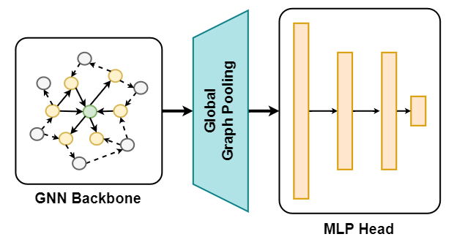
Graph Neural Networks (GNNs)
Graph Convolutions
Node-Level Embedding *
Pool Nodes **
Graph Prediction Head
Graph-Level Embedding
* Or compute edge embeddings
** Stop here for node-level
and edge-level tasks
2
5
4
1
3

Slide 9
Graph Neural Networks (GNNs)
Graph Convolutions
Node-Level Embedding *
Pool Nodes **
Graph Prediction Head
Graph-Level Embedding
* Or compute edge embeddings
** Stop here for node-level
and edge-level tasks
2
5
4
1
3
This part is the challenge!

Slide 10
Background
DL for Graphs
GNNs
Accelerators
GNNBuilder
Generic Compute
Architecture
Design Space Exploration
Performance Results
Framework API
Limitations
Ongoing Work
Documentation and Open Source
Generic Compute
Architecture
Design Space Exploration
GNNBuilder
Performance Results
Framework API

Slide 11
GNN Hardware Acceleration Landscape
EnGN
HyGCN
AWB-GCN
GRIP
Auten et al.
Zhang et al.
Rubik
GCNAX
GraphACT
BoostGCN
I-GCN
GenGNN
GNNBuilder
FlowGNN
FPL 2023
HPCA 2023
✅ Hardware Acceleration
❌ General Computation
❌ End-To-End Automation
✅ Hardware Acceleration
✅ General Computation
❌ End-To-End Automation
✅ Hardware Acceleration
✅ General GNN Computation
✅ End-To-End Automation

Slide 12
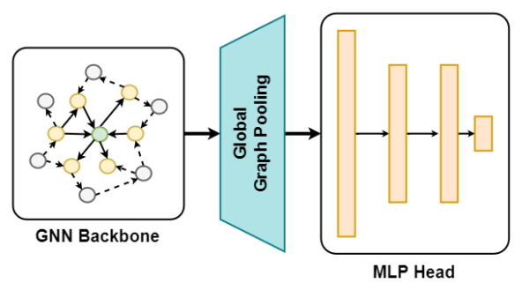





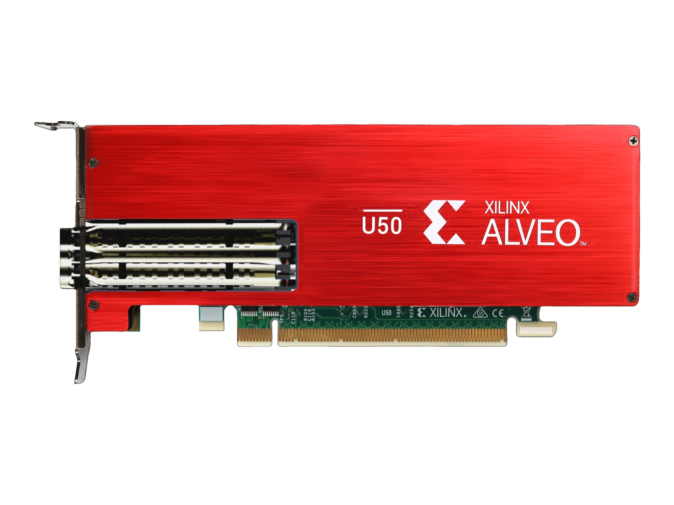
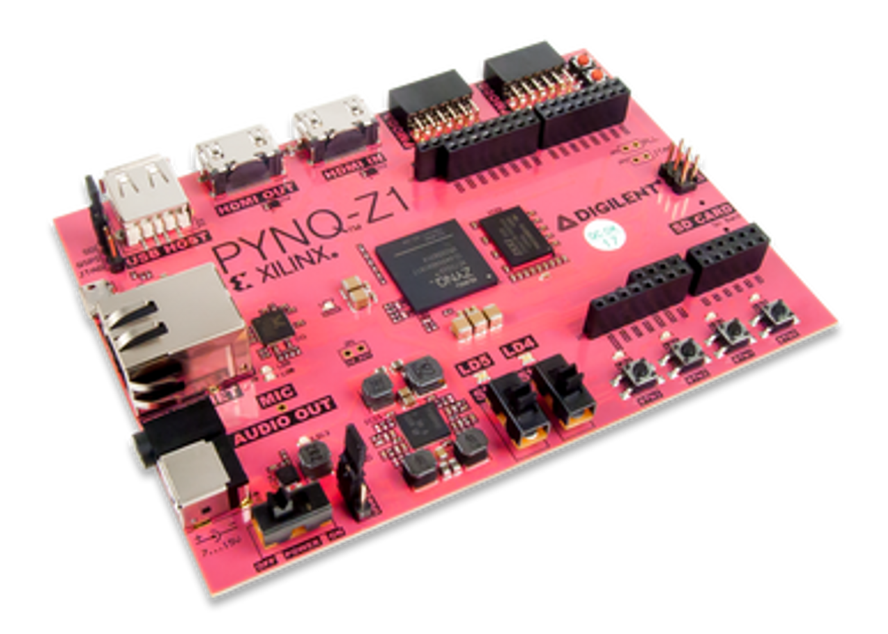
Design Workflow
!
!
FPGA
High-Level
Synthesis
Logic Synthesis
Physical Synthesis
C/C++
RTL (Verilog)
Netlist
Bitstream
!
Software Models are Always Changing
!
Hardware Design is Complex, Slow, and Requires Expert Knowledge
Platforms are Varied and Heterogeneous

Slide 13
GNNBuilder Overview
Generic Compute: wide range of GNN model support
Architecture: Parameterizable SW and HW model architecture
Design Space Exploration: ML-based DSE models
Performance Results: Better performance against CPU and GPU
Framework API: Open-source Python API with end-to-end workflow
Extensibility: Interoperability with PyTorch and extendable by anyone

Slide 14
Background
DL for Graphs
GNNs
Accelerators
GNNBuilder
Generic Compute
Architecture
Design Space Exploration
Performance Results
Framework API
Limitations
Ongoing Work
Documentation and Open Source
Generic Compute
Architecture
Design Space Exploration
GNNBuilder
Performance Results
Framework API

Slide 15
Generic Compute
Architecture
Software
Design Space Exploration
GNNBuilder
Compiler
Performance Results
Hardware
Framework API

Slide 16
“SpMM is Not All You Need”
“SpMM is All You Need”
Non-Sum Aggregation
PNA + GraphSAGE
Anisotropic Message Passing
Graph Attention Networks
Edge Embeddings
Almost all other cases…
Sum-Multiply Reductions
GCN + GIN+ GraphSAGE

Slide 17
“SpMM is Not All You Need”
“SpMM is All You Need”
EnGN
HyGCN
AWB-GCN
GRIP
Auten et al.
Zhang et al.
Rubik
GCNAX
GraphACT
BoostGCN
I-GCN
FlowGNN
GNNBuilder
✅ Hardware Acceleration
❌ General Computation
✅ Hardware Acceleration
✅ General Computation

Slide 18
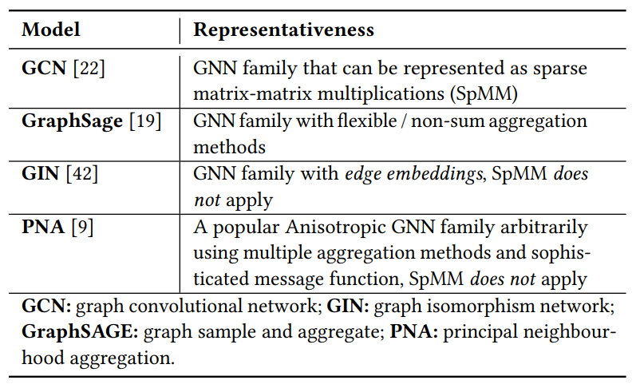
Generic Compute

Slide 19
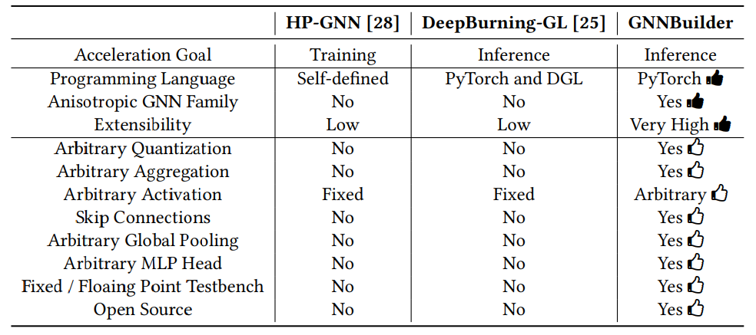
Generic Compute

Slide 20
Generic Compute
Architecture
Software
Design Space Exploration
GNNBuilder
Compiler
Performance Results
Hardware
Framework API

Slide 21
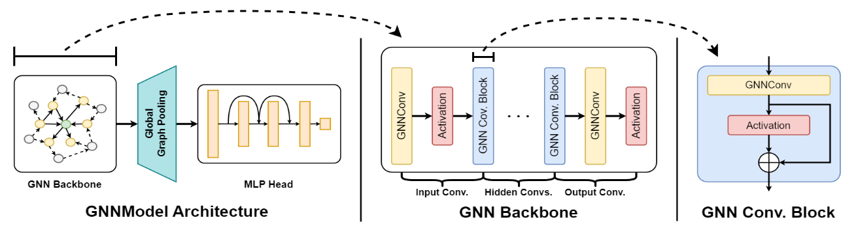
Model Architecture
Support a parameterized model architecture for node-level and graph-level tasks.

Slide 22
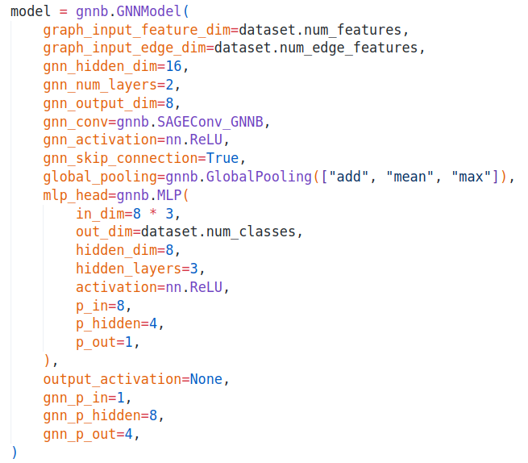
Model Architecture
Fully parameterized GNN model using PyTorch Geometric.
Notes:
The model behaves as a native PyTorch “nn.Module” and can be trained + used in deep learning workflows.

Slide 23
Generic Compute
Architecture
Software
Design Space Exploration
GNNBuilder
Compiler
Performance Results
Hardware
Framework API

Slide 24
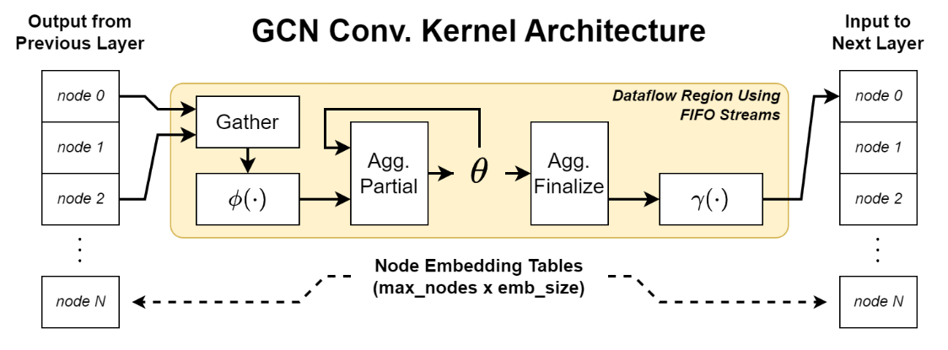
Hardware Architecture
We use an explicit message passing hardware kernel architecture for each graph convolution.

Slide 25
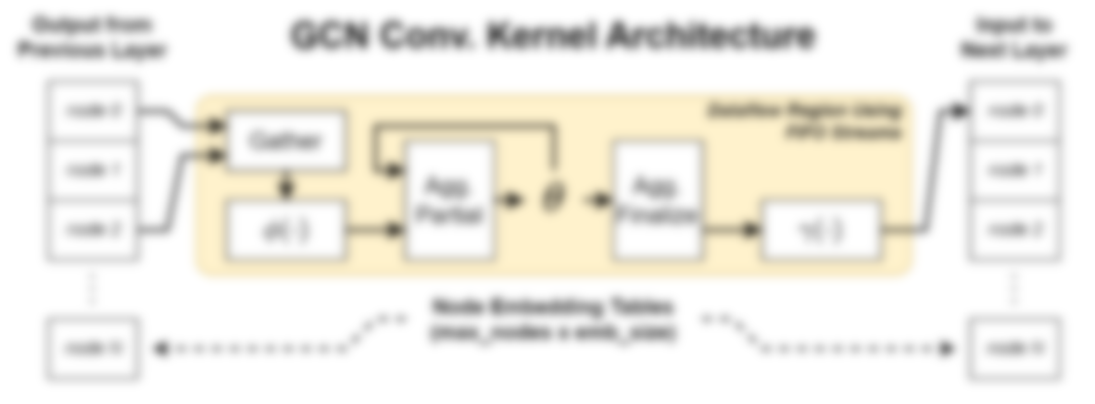
Hardware Architecture
The entire GNN Backbone is an “HLS DATAFLOW” region allowing for higher data throughput between layers without stalling.
#pragma HLS DATAFLOW
Graph Conv. Layer 1
Graph Conv. Layer 2
Graph Conv. Layer 3
Graph Conv. Layer 4
GNN Backbone

Slide 26
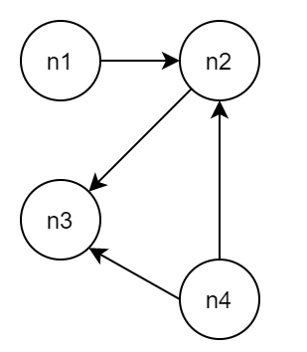
Graph Representation in Memory
We support COO (edge list) format for graph input.
We process the graph to create a degree table and neighbor table.
All this processing is done once on the device during inference.
COO Edge List
From:
1 | 2 | 4 | 4
2 | 3 | 3 | 2
Neighbor Offset Table
To:
0 | 0 | 2 | 4
Compute
Degree Tables
1 | 4 | 2 | 4
In-Degree:
0 | 2 | 2 | 0
1 | 1 | 0 | 2
Neighbor Table
Out-Degree:
n1
n2
n3
n4
Compute

Slide 27
Generic Compute
Architecture
Software
Design Space Exploration
GNNBuilder
Compiler
Performance Results
Hardware
Framework API

Slide 28
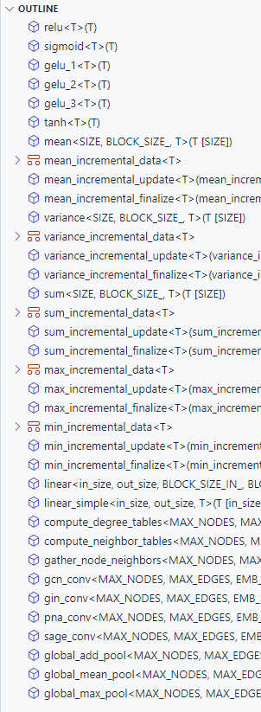
HLS Implementation
GNNBuilder comes with a modular C++ HLS header library for GNN compute!
Notes:
GNNBuilder comes with a modular C++ HLS header library for GNN compute!
This is where all the HW components are implemented for HLS.
Components of the same type (layers, aggregations, …) follow a common template and signature interface.
Open Source: anyone can look and use!
Each PyTorch Geometric layer has an equivalent hardware kernel:
GCN, GIN, GraphSAGE, PNA, …
Extra building blocks used throughout:
Linear Layers
Activations
Aggregations
Degree + Neighbor Table Processing

Slide 29
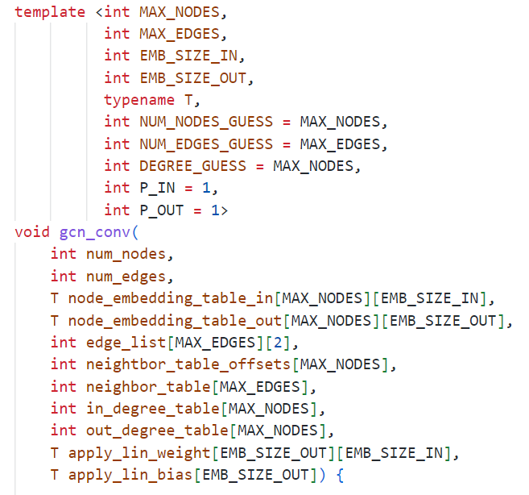
HLS Implementation
Break down key details of a GCN convolution layer.
Note how model parameters are passed down to the hardware.

Slide 30
HLS Implementation
Used for static array / memory sizing.
Set by user at design time based on dataset / workload.

Slide 31
HLS Implementation
Used for static array / memory sizing.
Used for passing in “ap_fixed” typedef as user-defined fixed-point datatype.
Set by user at design time based on task accuracy tradeoff.

Slide 32
HLS Implementation
Used for static array / memory sizing.
Used for passing in “ap_fixed” typedef.
Used for “#pragma HLS tripcount” to improve latency estimation.
Estimated from dataset / workload at design time.

Slide 33
HLS Implementation
Used for static array / memory sizing.
Used for passing in “ap_fixed” typedef.
Used for “#pragma HLS tripcount” to improve latency estimation.
Used to parallelize intra-layer operations such as node transformations.
Set by the user at design time based on perf. requirements and DSE exploration.

Slide 34
HLS Implementation
Used for static array / memory sizing.
Used for passing in “ap_fixed” typedef.
Used for “#pragma HLS tripcount” to improve latency estimation.
Used to parallelize intra-layer operations such as node transformations.
More details in the code repo. and documentation.

Slide 35
Generic Compute
Architecture
Software
Design Space Exploration
GNNBuilder
Compiler
Performance Results
Hardware
Framework API

Slide 36
Compiler and Code Generation
GNNBuilder implements a template-based compiler that lowers PyTorch models, down to a structured model IR, and then down to HLS C++ source code.

Slide 37
Compiler and Code Generation
We extract model and hardware architecture logic into individual compiler template components.
User Model
GNN Backbone
Config.
GNN Layer 0 Config.
Complete Accelerator HLS C++ Source
GNN Layer 1 Config.
GNNBuilder Compiler
GNN Layer n Config.
Skip Conn. Config.
GNN Layer Template
Activation Config.
Buffer Indexing Template
Global Pooling Config.
Agg. Config.
GNN Backbone
Dataflow Template
Agg. Config.
MLP Head
Config.
Linear Layer Config.
Graph Loading Template
Skip Conn. Config.
Top Level Kernel Template
Activation Config.

Slide 38
Extra Features
User specified fixed-point data type for features and weights
Uses ap_fixed format Xilinx HLS library
Also uses hls::math library
Auto build and run of C++ testbench using Clang
Can export PyTorch Geometric dataset to testbench files
Can use testbench as a correct model to explore quantization loss
Auto synthesis using Vitis HLS
Runs synthesis flow for a user-specified device and clock speed
Extracts synthesis results: latency + resource usage
Auto deploy to FPGA with host code (work in progress)
Run Vitis + Vivado build flow to generate .xclbin
Generate OpenCL host code to evaluate dataset (like testbench)
Looking into using XRT support in the PYNQ library to keep everything in Python

Slide 39
Background
DL for Graphs
GNNs
Accelerators
GNNBuilder
Generic Compute
Architecture
Design Space Exploration
Performance Results
Framework API
Limitations
Ongoing Work
Documentation and Open Source
Generic Compute
Architecture
Design Space Exploration
GNNBuilder
Performance Results
Framework API

Slide 40


Design Space Exploration
Predicting Latency and Resource Usage
Analytical Model
ML-Based Model
Config.
Success!
Generalizes Across Accelerator Configs.
Complete Failure!
Too Much Complexity
Notes:
Analytical Model
Look at HLS code and translate to Python model to calculate a rough estimate of clock cycles and resources.
Complete Failure!
Too much complexity in HLS synth + mapping and dynamic runtime workload make it hard to do this accurately.
Fitted Model
Use a random forest model and fit to a dataset of 400 randomly sampled model designs + configurations.
The ML model acts as a “smart interpolator” of the sparsely sampled configuration space.
Success!
This approach has good cross-validation error even with a very small sampled dataset of designs.

Slide 41
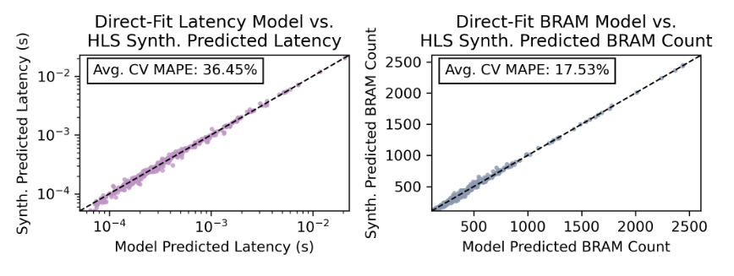
Design Space Exploration
MAPE: Mean Absolute Percent Error
Notes:
We achieve accurate predictions for latency and BRAM usage with low error that generalize to unfitted designs.

Slide 42
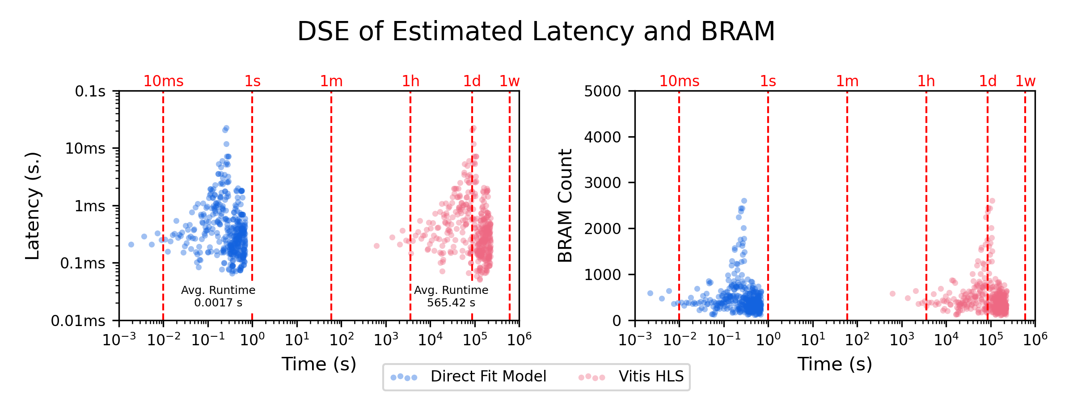
Design Space Exploration
Single DSE Model - 1.7 ms.
Single HLS Synthesis - 9.5 min.

Slide 43
Background
DL for Graphs
GNNs
Accelerators
GNNBuilder
Generic Compute
Architecture
Design Space Exploration
Performance Results
Framework API
Limitations
Ongoing Work
Documentation and Open Source
Generic Compute
Architecture
Design Space Exploration
GNNBuilder
Performance Results
Framework API

Slide 44
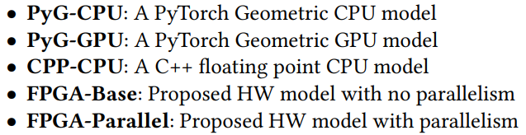
Accelerator Performance
CPU: Intel Xeon Gold 6226R
GPU: Nvidia RTX A6000
FPGA: Xilinx Alveo U280 @ 300 MHz.
We use a batch_size=1
across all evaluations for
real-time inference applications.

Slide 45
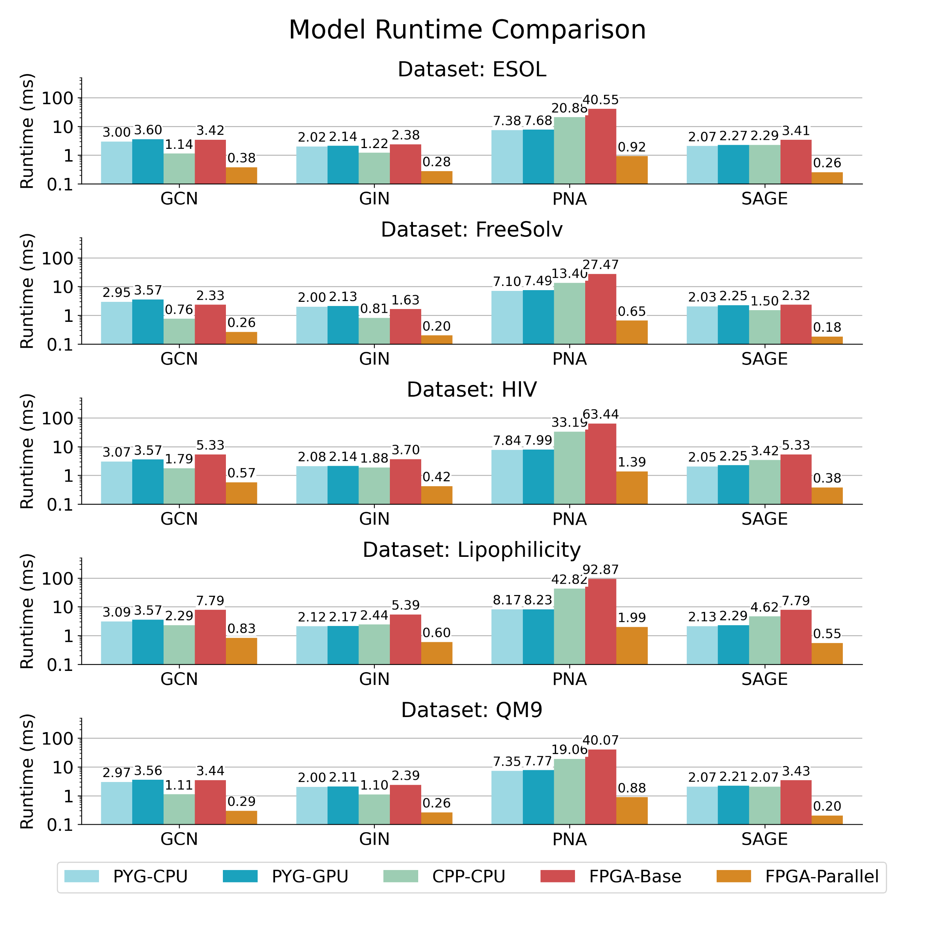
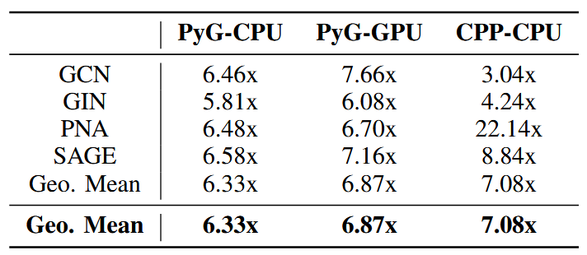
Accelerator Performance
We achieve consistent speedups overs CPU and GPU implementations!

Slide 46
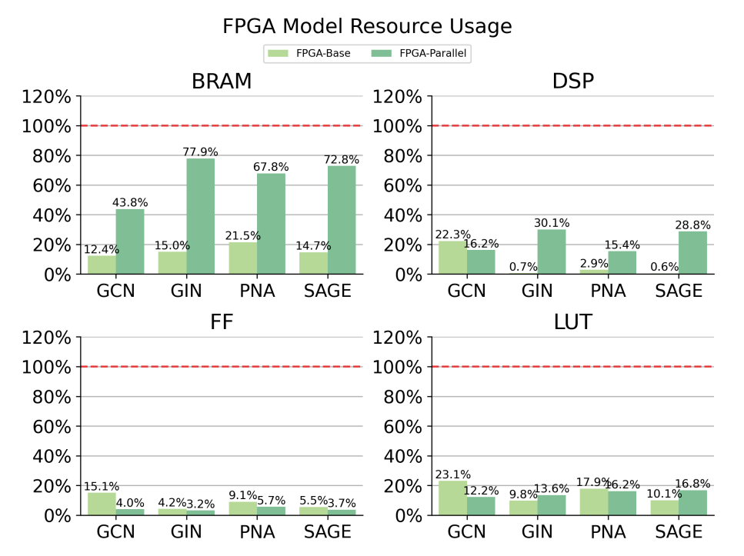
Accelerator Performance
Resource usage is dominated by on-chip memory (BRAM / URAM)

Slide 47
Background
DL for Graphs
GNNs
Accelerators
GNNBuilder
Generic Compute
Architecture
Design Space Exploration
Performance Results
Framework API
Limitations
Ongoing Work
Documentation and Open Source
Generic Compute
Architecture
Design Space Exploration
GNNBuilder
Performance Results
Framework API

Slide 48
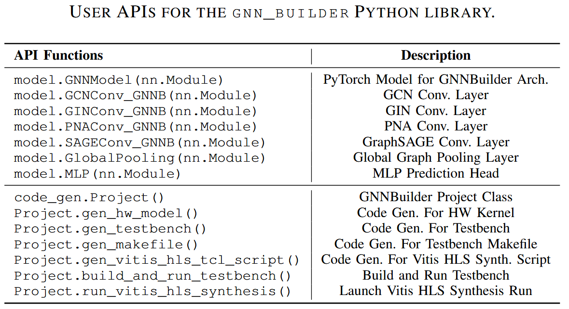
Framework API
Notes:
Both accelerator design generation and build flows are accessed via the GNNBuilder Python API.

Slide 49
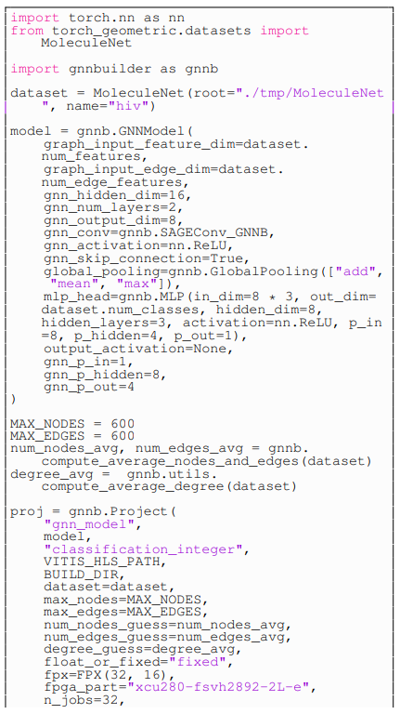
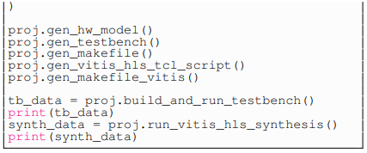
Minimum working example to generate, testbench, and synth a GNN accelerator.

Slide 50
Import GNNBuilder
Specify GNNBuilder Accelerator Project
(Define build path, device, tools, and fixed-point spec.)
Specify Dataset / Workload
Specific GNN PyTorch Model
(can be used for training)
(or load a pre-trained model)
Compile Down to HLS Design, Testbench, and Build Files
Call Tools to Run Hardware Testbench, Synthesis, and Implementation
Characterize Dataset / Workload Graph Properties
Minimum working example to generate, testbench, and synth a GNN accelerator.

Slide 51
Background
DL for Graphs
GNNs
Accelerators
GNNBuilder
Generic Compute
Architecture
Design Space Exploration
Performance Results
Framework API
Limitations
Ongoing Work
Documentation and Open Source
Generic Compute
Architecture
Design Space Exploration
GNNBuilder
Performance Results
Framework API

Slide 52
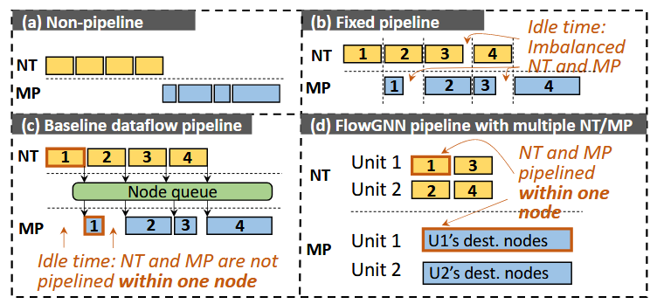
Limitations
GNNBuilder ⇒ 7x speedup vs. FlowGNN ⇒ up to 400x speedup
No Node-Level Parallelism in GNNBuilder
Each node is evaluated sequentially, nodes are not processed in parallel.
GNNBuilder
FlowGNN

Slide 53
Limitations
GNNBuilder ⇒ 7x speedup vs. FlowGNN ⇒ up to 400x speedup
No Node-Level Parallelism in GNNBuilder
Each node is evaluated sequentially, nodes are not processed in parallel.
Adapt dataflow pipelining and parallelism from previous GNN accelerator publications.
GenGNN and FlowGNN
GNNBuilder
FlowGNN

Slide 54
Background
DL for Graphs
GNNs
Accelerators
GNNBuilder
Generic Compute
Architecture
Design Space Exploration
Performance Results
Framework API
Limitations
Ongoing Work
Documentation and Open Source
Generic Compute
Architecture
Design Space Exploration
GNNBuilder
Performance Results
Framework API

Slide 55
Ongoing Work
Large Graph Support via Efficient Off-Chip HBM Access
Irregular unknown memory access patterns at runtime
Automated XRT and PYNQ On-Device Deployment and Evaluation
Expand Support for Novel GNN and NN Features
GAT, SimpleConv, Graph Sampling, Embedding Lookup Layers, Complex Edge Convs, …
Multi-Tiered Accelerator Evaluation API
Fitted Models → LightningSim Co-Simulation → Vitis HW Emulation → On-Device Evaluation
Application Demos and Deployment
High Energy Physics Triggers and Reconstruction, Real Time Point Cloud Processing, …

Slide 56
Background
DL for Graphs
GNNs
Accelerators
GNNBuilder
Generic Compute
Architecture
Design Space Exploration
Performance Results
Framework API
Limitations
Ongoing Work
Documentation and Open Source
Generic Compute
Architecture
Design Space Exploration
GNNBuilder
Performance Results
Framework API

Slide 57


Source Code + Documentation + Setup
🚧
pip install git+https://github.com/sharc-lab/gnn-builder.git
🚧
conda install --channel https://sharc-lab.github.io/gnn-builder/repo gnn-builder
Source Code
Documentation + Tutorials
github.com/sharc-lab/gnn-builder
sharc-lab.github.io/gnn-builder/

Slide 58
How to Add a New Graph Convolution Layer
Clone the repo…
Add HW kernel to header library…
Add associated layer wrapper to Python library…
Add the relevant compiler template unit…
Run testbench and synth…
Submit pull request…
See documentation for detailed walkthroughs and tutorials.

Slide 59
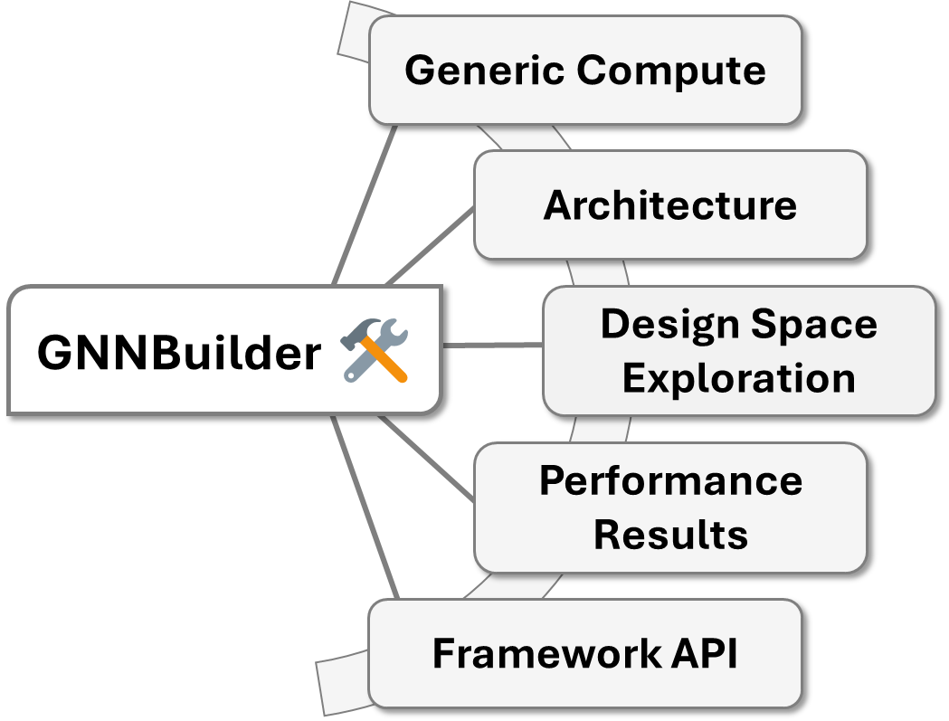



GNNBuilder An Automated Framework for Generic Graph Neural Network Accelerator Generation, Simulation, and Optimization
Stefan Abi-Karam
stefanabikaram@gatech.edu
SHARC Lab @ Georgia Tech
sharclab.ece.gatech.edu
TMPO / CIPHER
Georgia Tech Research Institute
Interested in perusing academia…

Slide 60
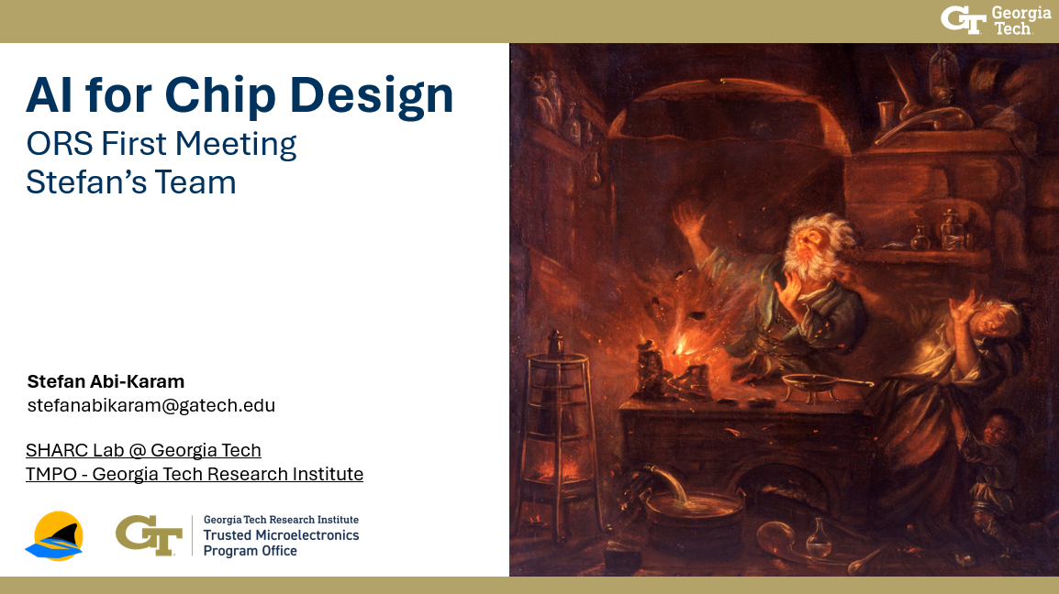
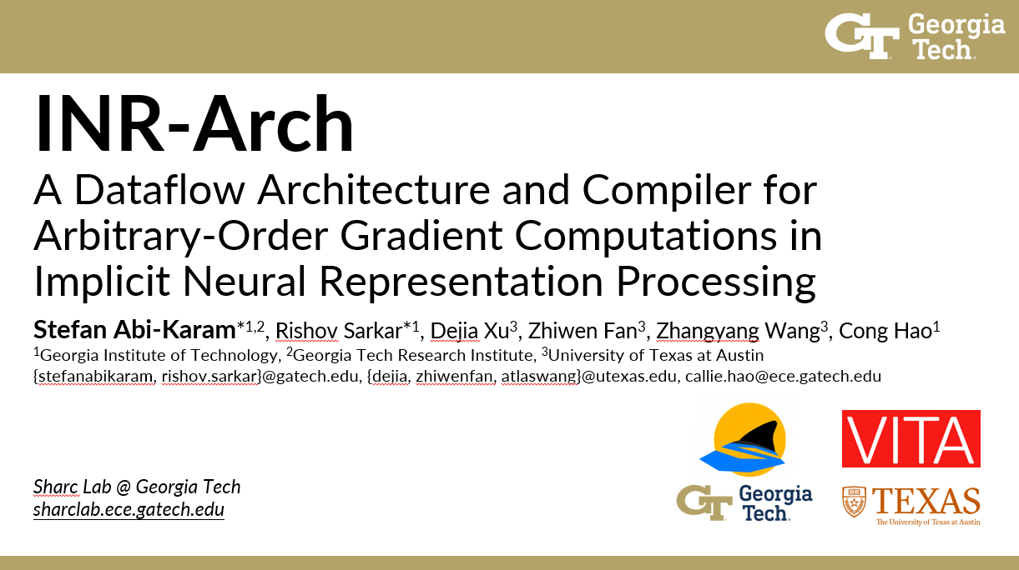

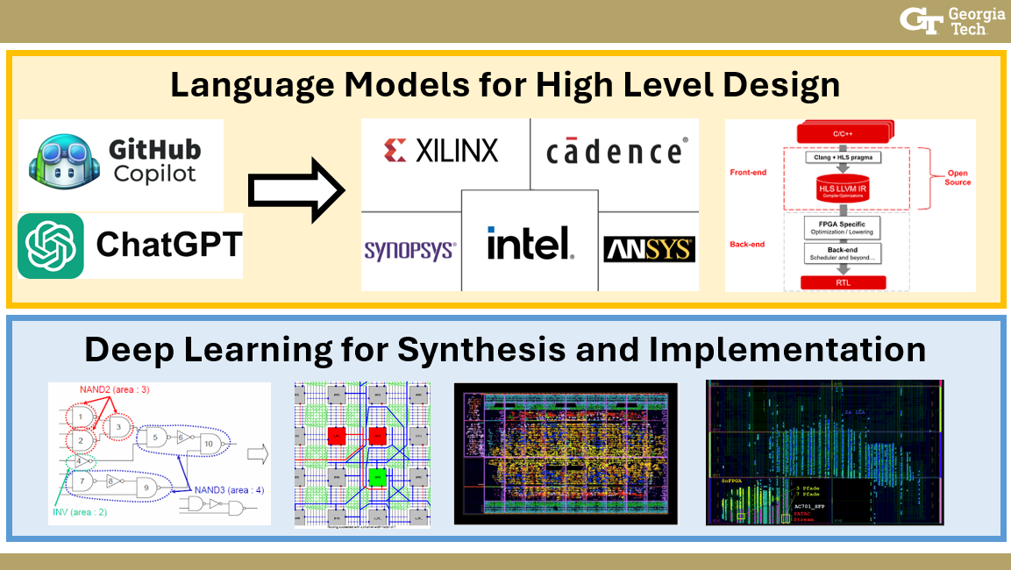
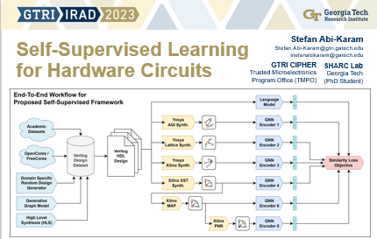
New Research Direction
External Collaborations
Stefan Abi-Karam
Research Faculty
Ph.D. Student
stefanabikaram@gatech.edu
stefanabikaram.com
Undergraduate Student Mentoring
Raised $60K Internal Research Funding

Slide 61

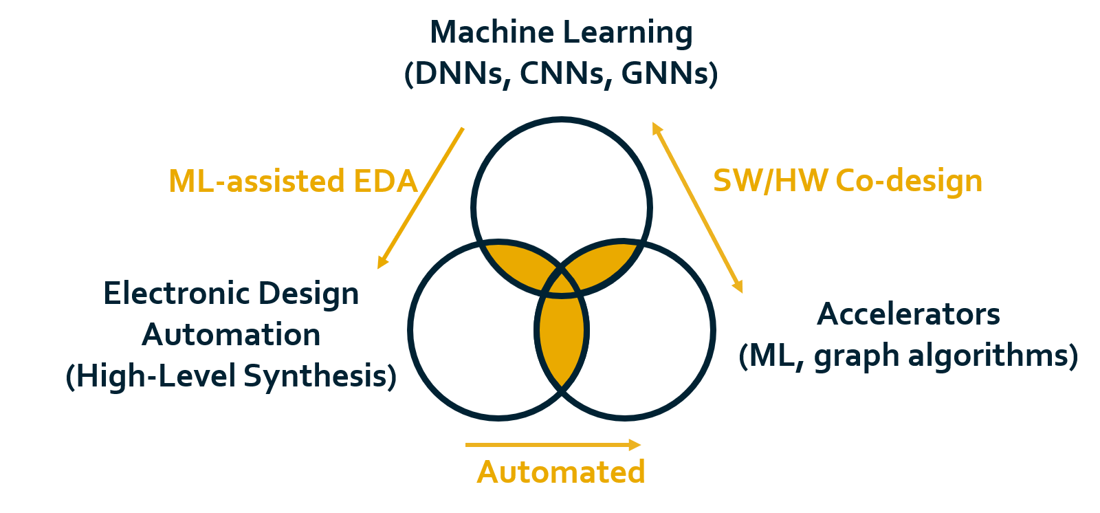
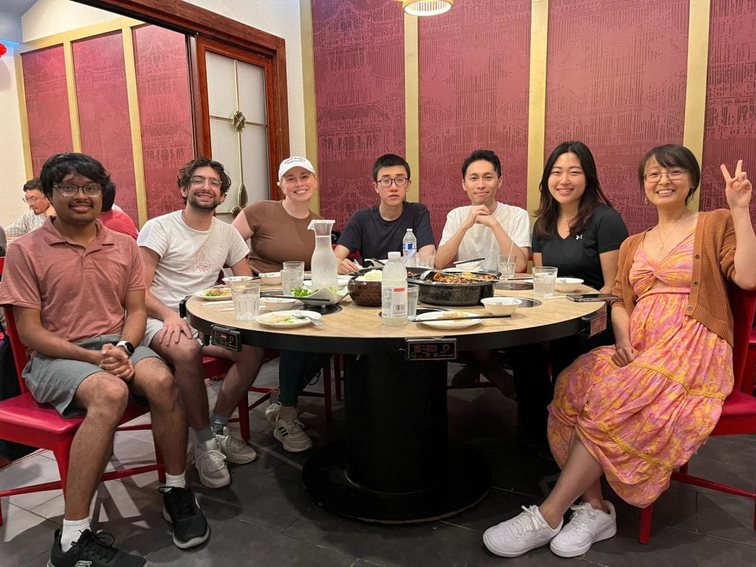

Sharc Lab @ Georgia Tech
Prof. Callie Hao

Slide 62
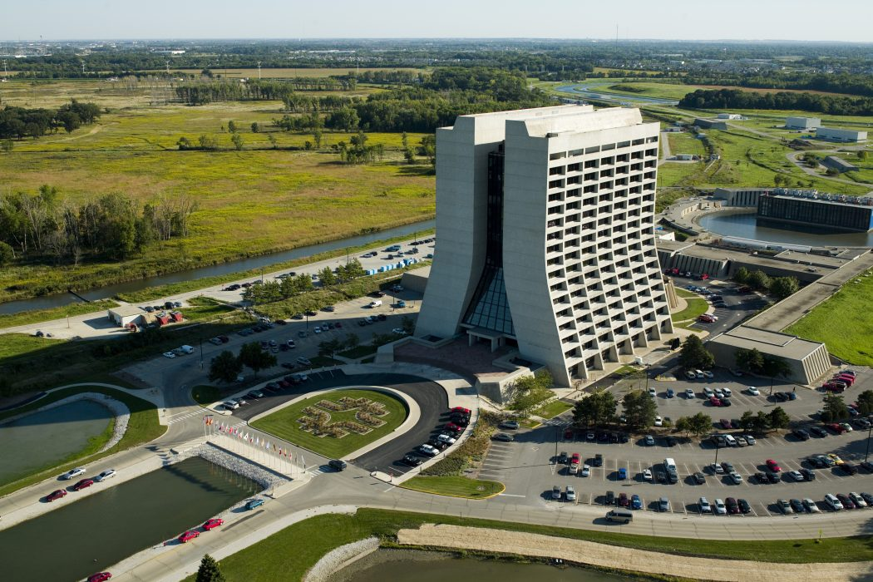
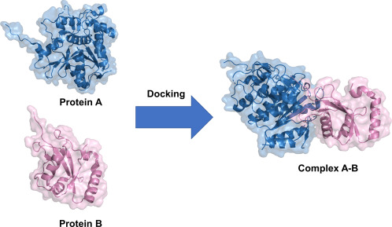
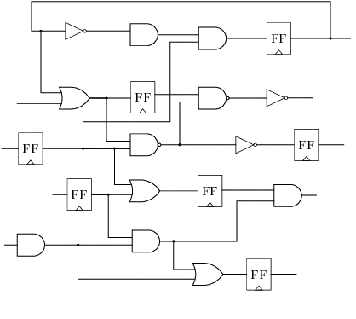
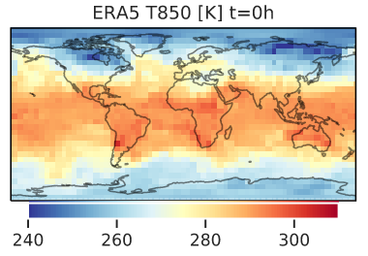
Deep Learning on Graphs
Physics Modeling
Weather Forecasting
Point Cloud Processing
High Energy Physics!
Scene Graph Understanding
Social Network Analysis
Recommender Systems
Source Code Analysis
Drug Discovery
NLP
Fraud Detection
HW/SW Co-Design
Smart EDA Tools
Hardware Security
…
…
Many more…
Doesn’t Need Inference Acceleration
Benefits From Inference Acceleration

Slide 63
Accelerator Performance
All benchmarks share the following model parameters:
GNN Hidden Dim | 128
GNN Hidden Layers | 6
GNN Output Dim | 64
GNN Activation | ReLU
GNN Skip Connections | True
Global Pooling | [add, mean, max]
MLP Head Input Dim | 64 x 3
MLP Hidden Dim | 64
MLP Hidden Layers | 4
MLP Activation | ReLU
We use a batch size of 1 across all evaluations.
For real time inference applications such as high energy physics triggers or autonomous vehicles, this is a reasonable assumption to make. We are unable to batch data in these cases.
If batching is needed, multiple graphs can be treated as one disconnected graph.

Slide 64
Accelerator Performance
Evaluated Fixed Point Types
Model Type | Fixed-Point Type
FPGA-Parallel: GCN, SAGE, GIN | ap_fixed<16, 10>
FPGA-Parallel: PNA | ap_fixed<16, 10>
FPGA-Base | ap_fixed<16, 32>
CPU: Intel Xeon Gold 6226R
GPU: Nvidia RTX A6000
FPGA: Xilinx Alveo U280 @ 300 MHz.
Evaluated Parallelism Factors
Model Type | Input Parallelism | Hidden Parallelism | Output Parallelism
FPGA-Parallel: GCN, SAGE, GIN | gnn_p_in=1, p_in=8 | gnn_p_hidden=16, p_hidden=8 | gnn_p_out=8, p_out=1
FPGA-Parallel: PNA | gnn_p_in=1, p_in=8 | gnn_p_hidden=8 | gnn_p_out=8, p_out=1
FPGA-Base | 1 | 1 | 1

Slide 65
Accelerator Performance
Based on results from FlowGNN we can roughly estimate power efficiency.
Approximate FPGA power: ~30W
Approximate GPU power: ~70W
This results in a ~2.33x approximate power efficiency margin for the same throughput between devices.
Memory efficiency has yet to be profiled.
This is under the current work to support large graphs, HBM support, and graph sampling.
We achieve consistent speedups overs CPU and GPU implementations!

Slide 66
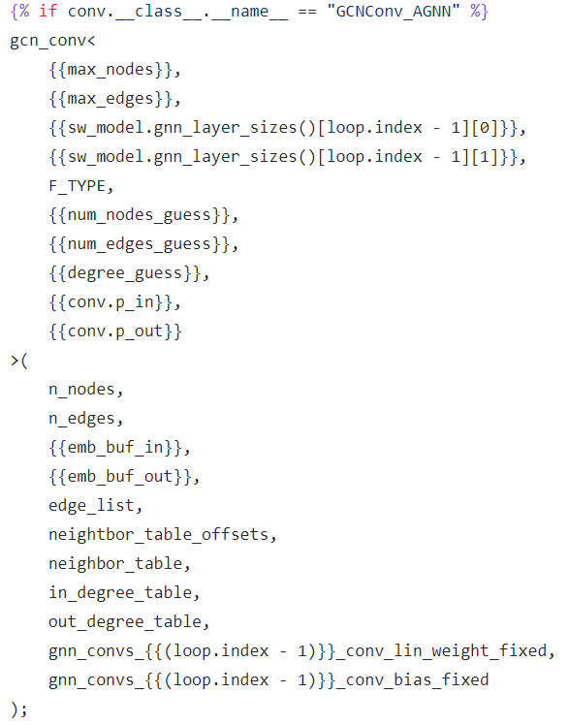
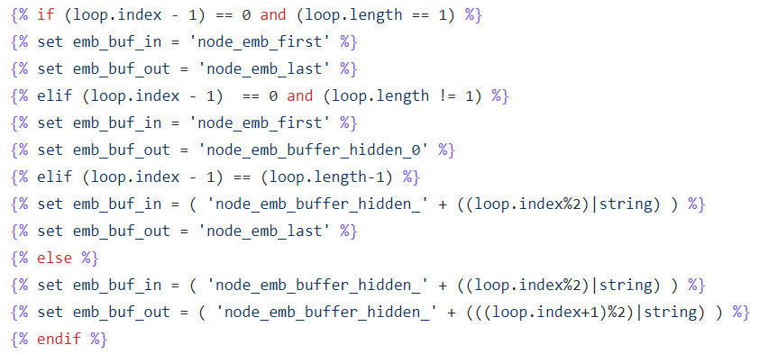
Compiler and Code Generation
We extract model and hardware architecture logic into individual compiler template components.
Figure out which double buffer or input / output buffer to use for each layer.
Mapping PyTorch layers and parameters to hardware kernels.

